Slide 1

Blue Team
Log Analysis and Attack Characterization
1

Slide 2
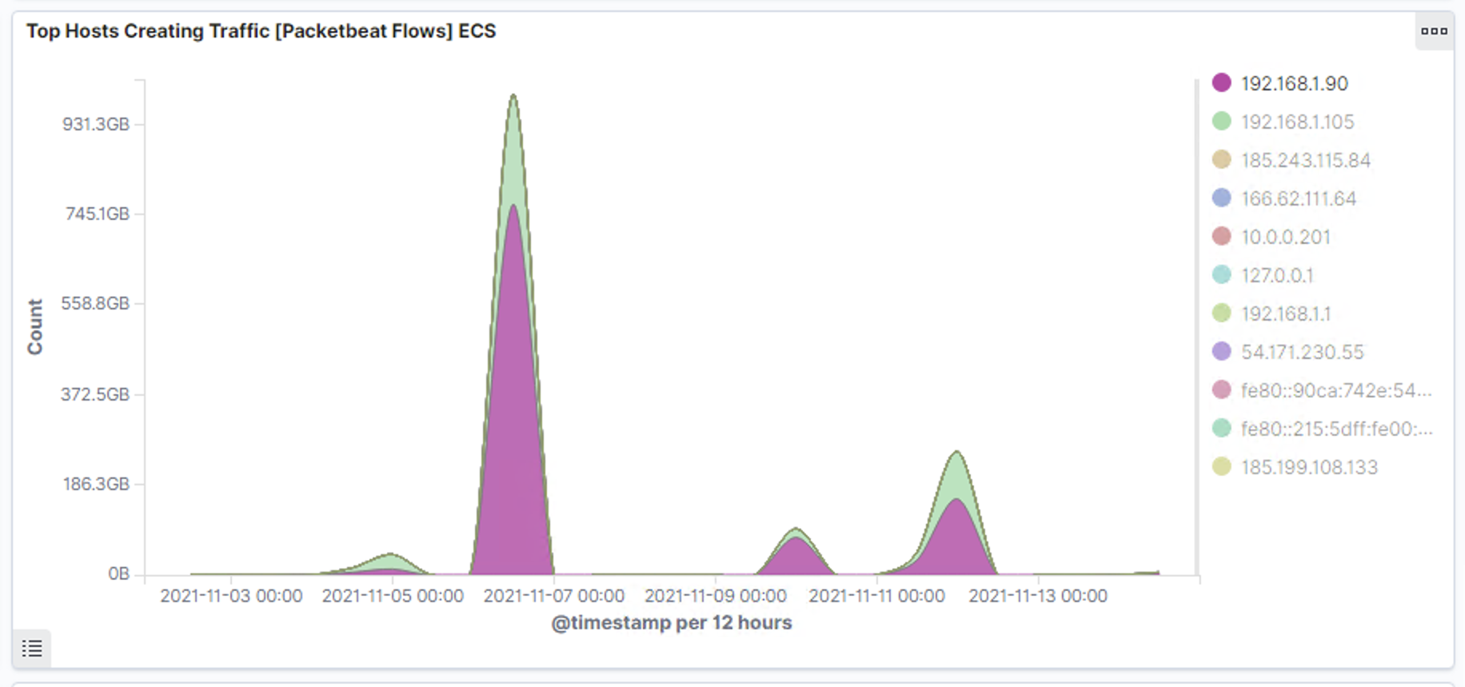
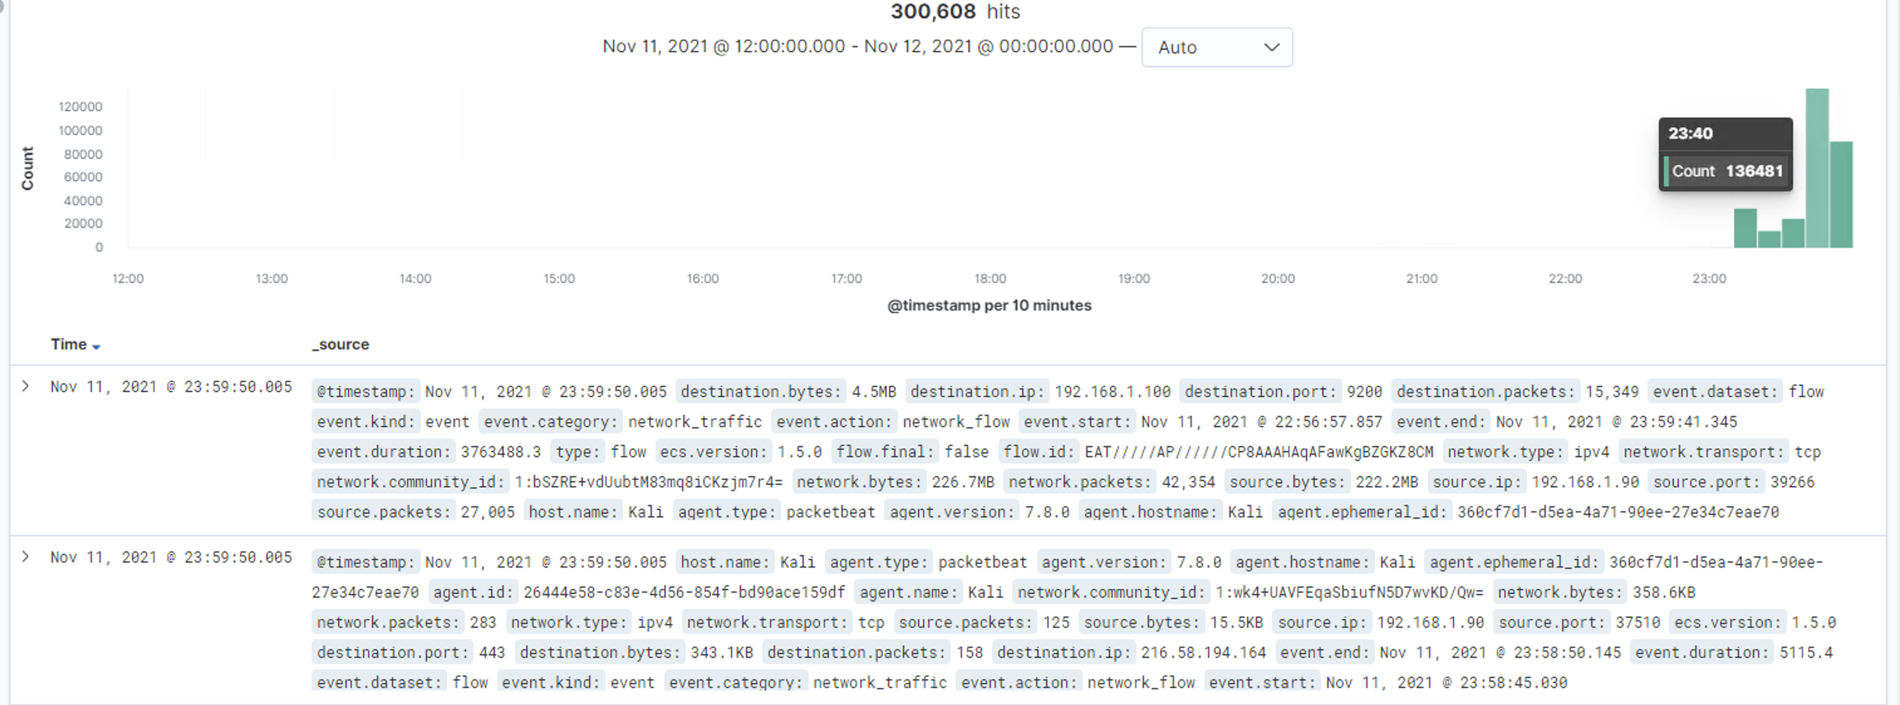
Analysis: Identifying the Port Scan
.
Port scan started on Nov 11th, 2021 at midnight
Around 136841 packets worth 740GB were sent with the source IP of 192.168.1.90
The sudden huge peak in network traffic indicates that this was indeed a port scan
[Insert Here]
Include a screenshot of Kibana logs depicting the port scan.

Slide 3
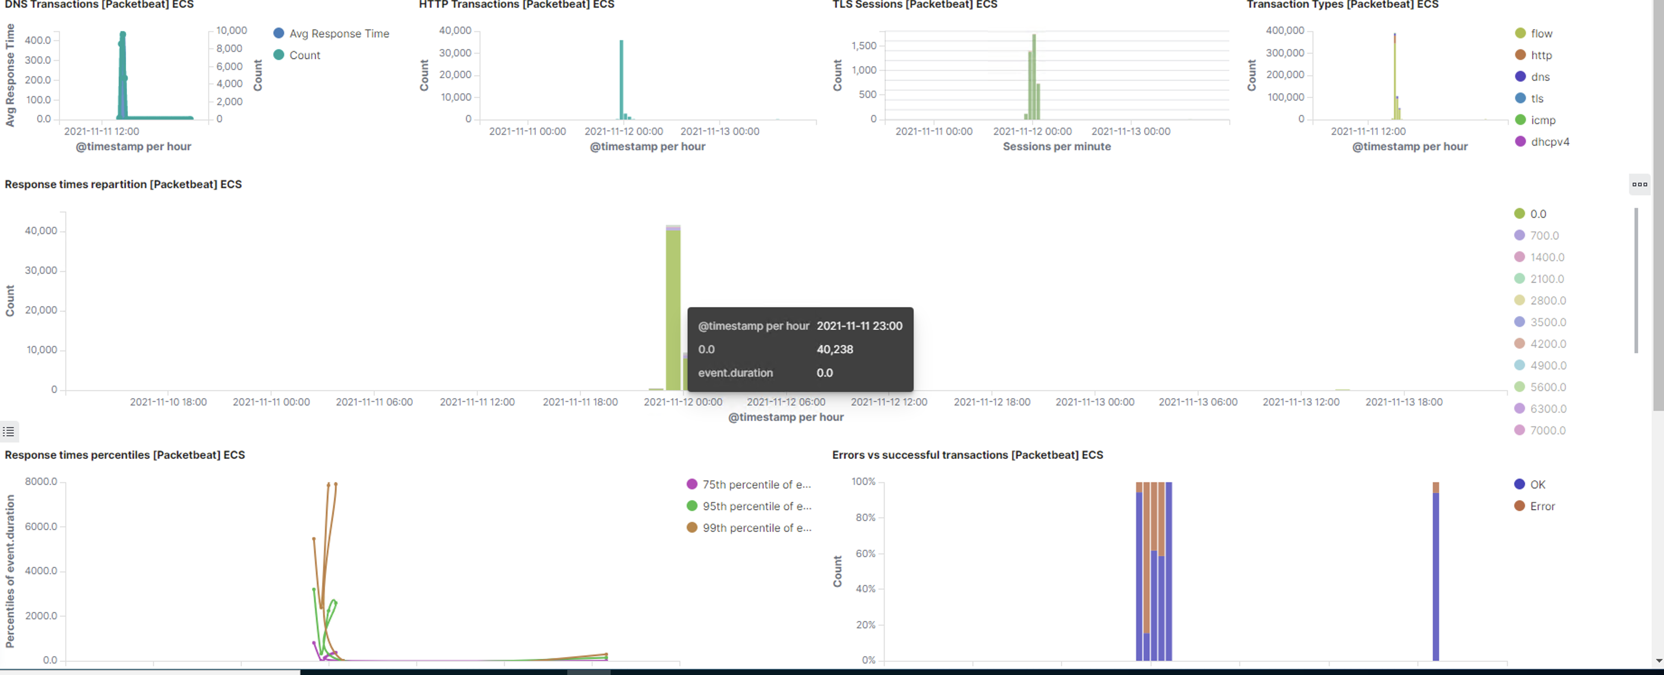
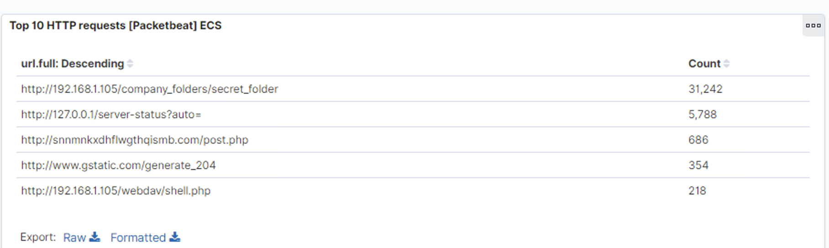
Analysis: Finding the Request for the Hidden Directory
On the 11th of Nov, 21 40238 requests were made to access the /secret_folder
The /secret_folder contained a hash that’s usable for system access using Ryan’s credentials
The /secret_folder allowed me to upload a payload, further exposing the system

Slide 4
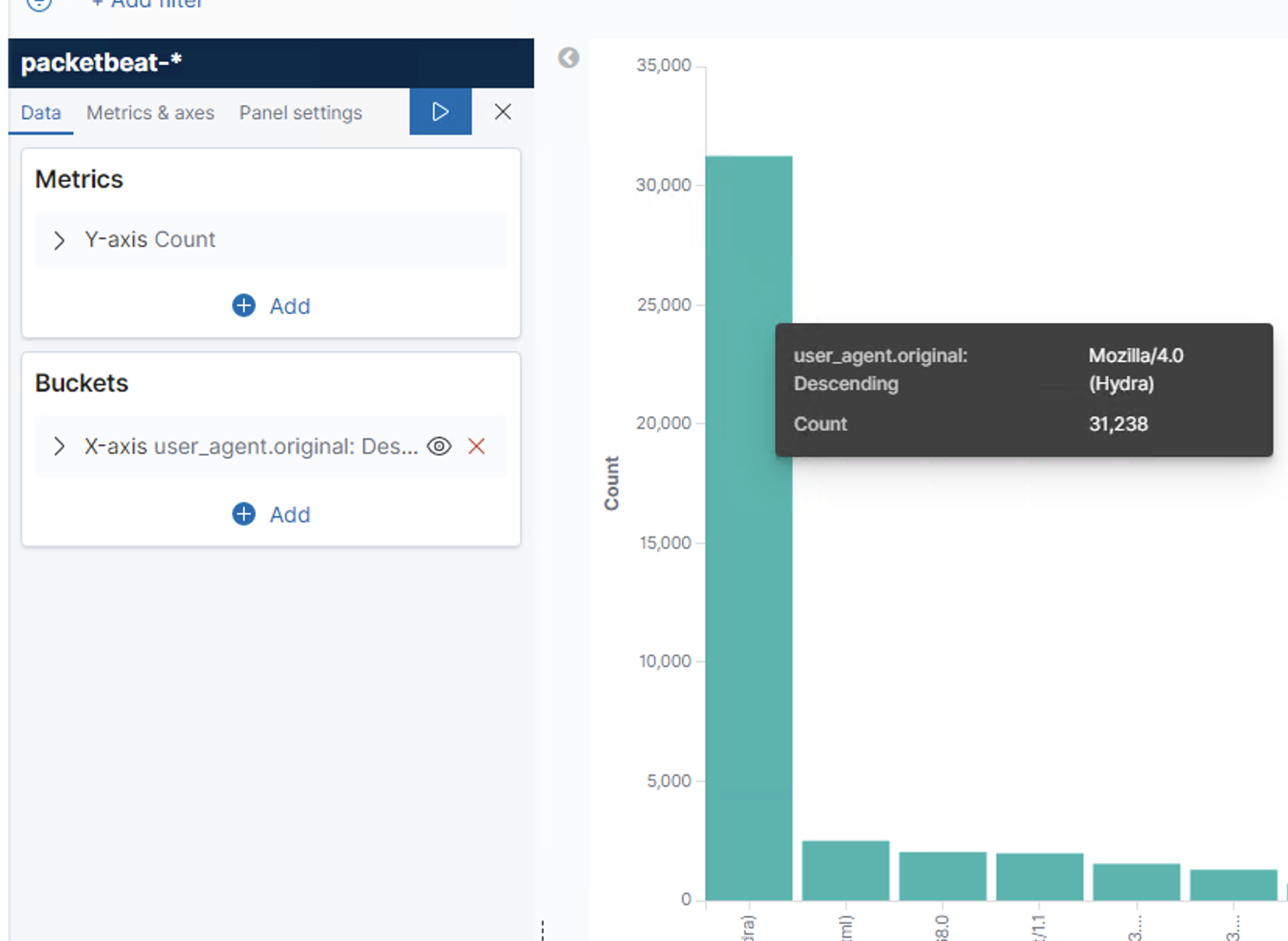
Analysis: Uncovering the Brute Force Attack
143332 hits were made with Hydra
35 attacks were successful that returned 301 HTTP status code “Moved Permanently”
.

Slide 5
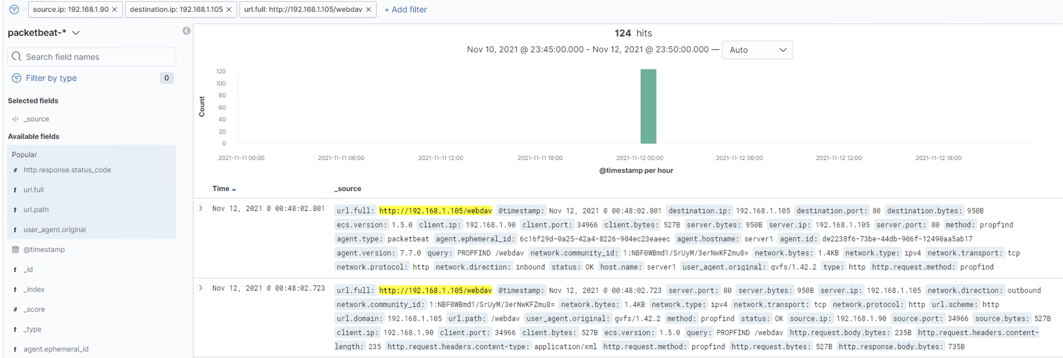
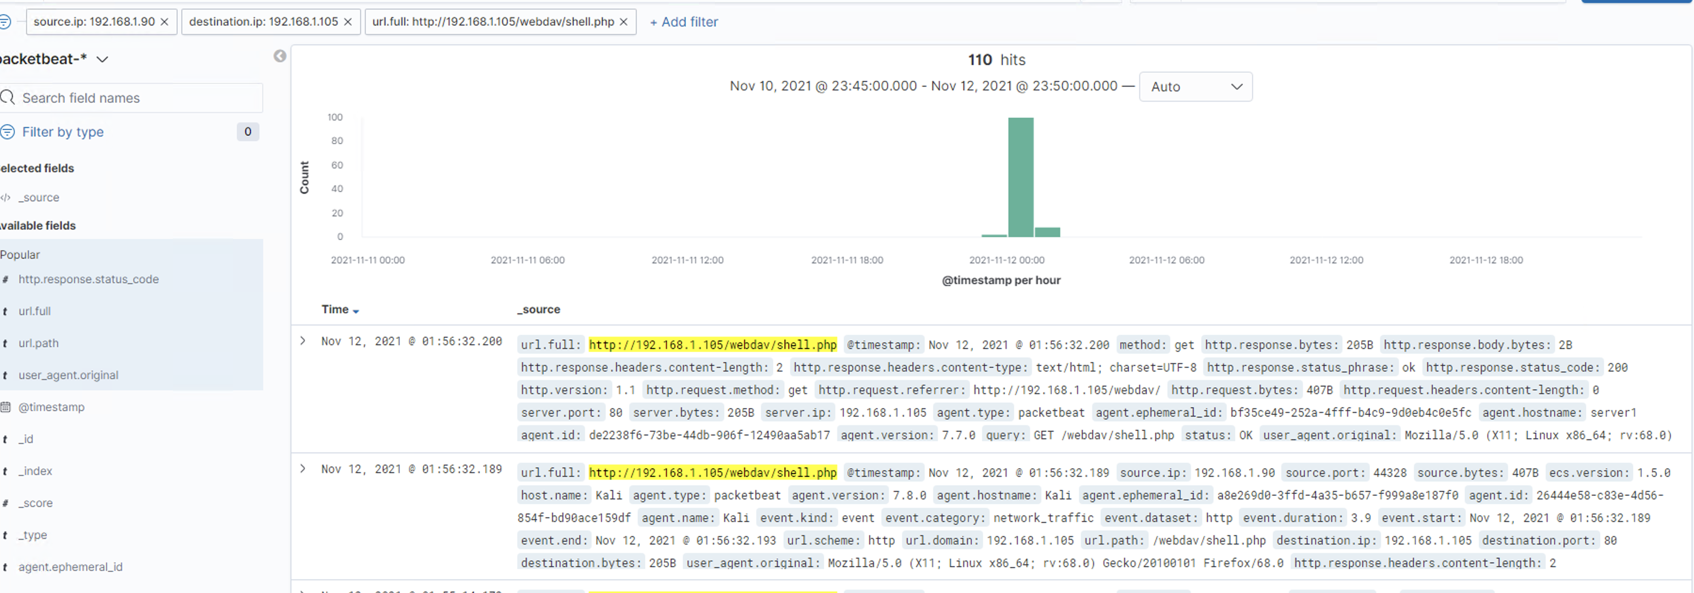
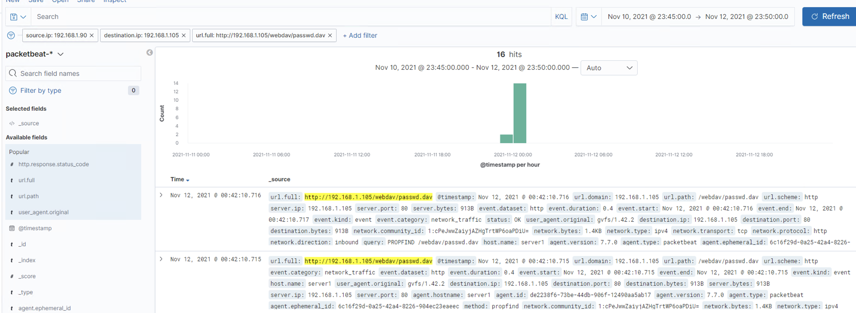
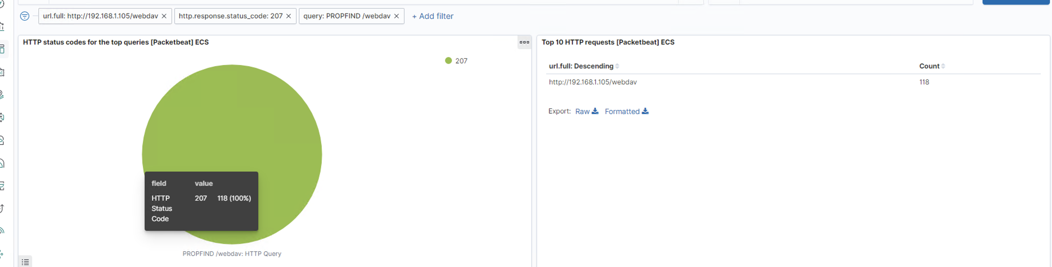
Analysis: Finding the WebDAV Connection
.
124 attempts were made to access the /webdav directory
16 hits were made to access /passwd.dav and 110 hits were made to access /shell.php files

